Slide 1
Deploy Cloud Native Application on OpenShift
Ritu Maheshwari
Developer Advocate

Slide 2
This lab demonstrates how to deploy an application to OpenShift when the source code is available in a GitHub repository.

Slide 3
Steps for the lab: Step 1: Create a new project 'deployment-from-github’ Step 2: Create a new application and refer to a subdirectory in the GitHub repo Step 3: Verify if the service is created Step 4: In the last step create a route

Slide 4
FROM maven:3.5-jdk-8 as BUILD COPY src /usr/src/app/src COPY pom.xml /usr/src/app RUN mvn -f /usr/src/app/pom.xml clean package FROM open-liberty:microProfile2-java11 COPY liberty/server.xml /config/ COPY --from=BUILD /usr/src/app/target/authors.war /config/apps/ EXPOSE 3000
Dockerfile

Slide 5
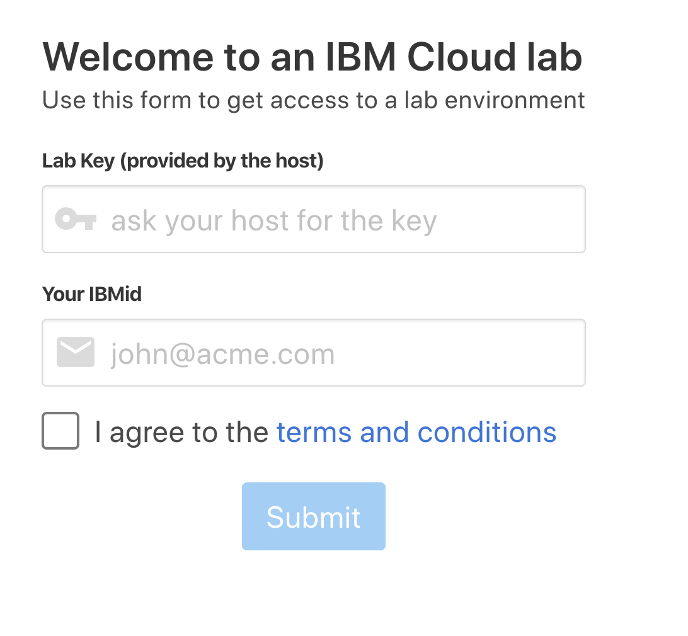
Get Environment for Lab:
To get Environment Access use the following URL: https://oswiprocp.mybluemix.net
Enter the Lab Key: oslab
Provide the Email ID used to sign up for IBM Cloud
Check the box to agree to the terms and conditions
Click on Submit.

Slide 6
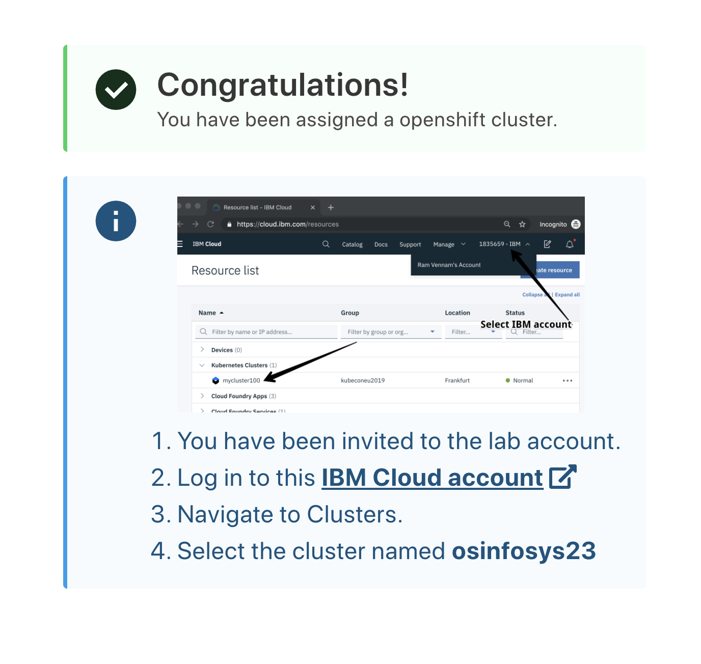
Get Environment for Lab:
Login to IBM Cloud Account

Slide 7
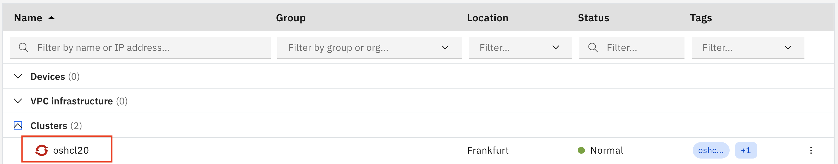
To access the cluster click on the name of the cluster as highlighted below:

Slide 8
Lab Time !
https://github.com/IBMDevConnect/cloudpakforappsbadge/tree/master/CloudNativeAppDeployment

